Slide 1
DETERMINATION OF WATER RESOURCE CLASSES AND ASSOCIATED RESOURCE QUALITY OBJECTIVES IN THE INKOMATI WMA
PUBLIC MEETING
Date: 12 JUNE 2013
Time: 09:00
Venue: Bundu Country Lodge, Nelspruit
Mohlapa Sekoele

Slide 2
PRESENTATION CONTENT
  The Water Resource Classification System (WRCS)
  Resource Quality Objectives (RQOS)
  Study Area
  Process for the classification of water resources and determination of the Resource Quality Objectives in the Inkomati WMA

Slide 3
LEGAL MANDATE
The classification of South African water resources is required by the National Water Act (NWA) (No. 36 of 1998) (Chapter 3 regarding the protection of water resources)
  Class
  Reserve (Preliminary)
  Resource Quality Objectives
  (RDM–Set objectives for the desired condition of water resources)
Regulation 810 published in Government Gazette No. 33541 dated 17 September 2010 defined water resource management classes and the procedure to determine a Class
According to the NWA, once the WRCS has been gazetted all significant water resources must be classified

Slide 4
INTEGRATED WATER RESOURCE MANAGEMENT
Catchment
Vision
Societal values and aspirations
Desired state of water resources
Catchment Assessment including current state
Management Class
Monitoring
Determine RQOs and Reserve
Compliance
State
Catchment Management Strategy
Water Use Control
Resource Management Strategy
Source Directed Management Strategy
Other strategies
End of pipe standards
Management plans
Water use authorisations
Allocation schedule (quality and quantity)
Strategic use; International obligations;
future use;
inter-basin transfers

Slide 5
CLASSIFICATION SYSTEM
The WRCS provide guidelines and procedures for setting different MC (MCs) ;
MC describes what state the water resources need to be in to satisfy beneficial use;
MC facilitates the balance between protection and use of the water resources;
MC is defined by taking into account the social, economic & ecological landscape;
Process requires co-operation & transparency with all stakeholders.

Slide 6
THREE MANAGEMENT CLASSES (MC)
Classes | Description of use | Ecological categories
Class I | Minimally used | A-B
Class II | Moderately used | C
Class III | Heavily used | D & lower
Ecological Category (EC) - means the assigned ecological condition to a water resource in terms of the deviation of its biophysical components from a pre-development condition.

Slide 7
RESOURCE QUALITY OBJECTIVES (RQOS)
RQOs are numeric or descriptive statements of conditions which should be met in the receiving water resource;
RQOs represent the requirements for water quantity, quality, and habitat and biotic integrity to be maintained in aquatic ecosystems.
They are targets that can be measured/audited, and can be used as benchmarks to monitor a combined resource that may have several licensed users.
RQOs provide measurable goals that give direction as to how the resources need to be managed.

Slide 8
THE LINK OF RQOS WITH WATER RESOURCE CLASSIFICATION
Vision for the Resource
Classification of Water Resources
Ecological Requirements
User Requirements
Management Class for each resource unit
Resource Quality Objectives
(Quantity, quality, habitat, biota)
Develop Implementation & monitoring plan
Implementation of Ecological Requirements through Source Directed Controls
Implementation of User Requirements through Source Directed Controls

Slide 9
Classification and RQOs Determination
The determination of classes and RQOs is a step-wise process consisting of:
Assessment of the study area and delineate the IUAs
Identify and evaluate the scenarios
Setting of the class, userspecs and ecospecs
Stakeholder engagement

Slide 10
HOW WILL CLASSES AND RQOS ASSIST IN THE MANAGEMENT OF THE CATCHMENT?
The catchment vision requires a desired state of the water resources
RQOs will give effect to the implementation of the MCs
There will be management framework describing the following:
  The extent to which every significant water resource can be used, and
  The level of protection every significant water resource will be afforded.
Develop plan of action for implementation of recommended classes and RQOs which must include a monitoring programme.

Slide 11
Determination of CLASSES AND RQOs IN THE INKOMATI WMA

Slide 12
Determination of CLASSES AND RQOs IN THE INKOMATI WMA
The study was initiated in April 2013: still in the inception phase
Timeframe: 24 months
IWR Water Resources was appointed to assist DWA
The objective of the study is to determine classes and RQOs in the Inkomati WMA

Slide 13
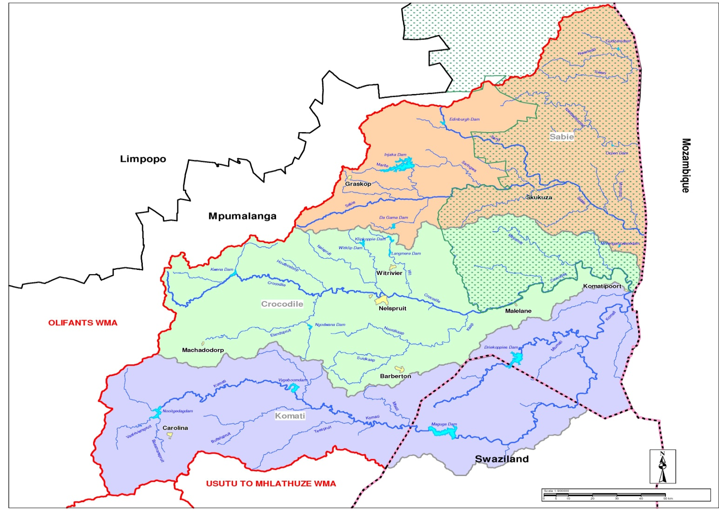
STUDY AREA

Slide 14
GUIDING PRINCIPLES ON THE PROJECT
Alignment with the existing work and current studies
Transparency and Stakeholder engagement
Consultation and collaboration
The classification and determination of the RQOs are step-wise processes

Slide 15
STUDY PROCESS
  In accordance with the classification and RQOs guidelines: 7 step process applies
Assessment of WMA
Divided catchment into management units (IUAs) based on socio-economic/
land use characteristics/
water resources(IUAs)
Data assessed
Status quo understood
Catchment vision initiated
Link value and condition of water resources
Goods and services assessed
Economic Framework for decision making developed
Ecological requirements of water resources understood and quantified
How much water does the ecology require for different protection levels
Identification and evaluation of scenarios
Set of scenarios tested for sustainability and evaluated
Understand the implications of different protection levels
Recommended Management classes &RQOs
To set EcoSpecs and user specs
Gazetting
To gazette Classes, Reserve and
RQOs
1
2
3
4&5
6
7
Stakeholder engagement
April 2013 to March 2015

Slide 16
STAKEHOLDER ENGAGEMENT

Slide 17
PURPOSE OF THE STAKEHOLDER ENGAGEMENT PLAN
To engage with stakeholders on the determination of the Management Classes & RQOs in the Water Management Area
To extend stakeholder engagement to all the key stakeholders
To have one-on-one meetings with the key stakeholders who could not attend the workshops
To communicate Communication Plan for the study
Notes:
17

Slide 18
OBJECTIVES OF THE STAKEHOLDER ENGAGEMENT PLAN
To improve the management process of this project.
To reduce the potential for future conflict.
To enable the Department and stakeholders to share knowledge and expertise.
To inform and educate stakeholders about the Department’s function and responsibilities.

Slide 19
TARGETED STAKEHOLDERS
  Agriculture – Agri SA, NAFU, Irrigation boards, Tvl Agric Union of SA
  Emerging Farmers
  Mining – COM and mining houses
  Industries – Eskom, SAPPI, TSB Sugar, etc
  Local government – local and district municipalities in WMA
  Conservation – SANBI, Sanparks, WESSA, Bird Life Africa
  NGOs – Federation of Sustainable Environment,
  Regulators – DWA & DEA (regional and national), DMR, Department of Agriculture, Land Affairs
  Water Service Authorities/Providers- SembCorp, BCT Water, etc

Slide 20
TARGETED STAKEHOLDERS [Cont.]
  Information/Academic institutions – libraries, universities
  Unions & House of Traditional leaders
  Catchment Forums & WUA
  Civil society and the environment representatives
  Community members (public at large)

Slide 21
COMMUNICATION METHODS/ APPROACH
Direct –Stakeholder meetings
    - Distribution of documents and presentations for comments
Interviews – One-on-One meetings
Printed Documents – BID, Newsletters &Brochures
Electronic media – DWA website: www.dwa.gov.za/rdm/WRCS/default.aspx
        ICMA website: www.inkomaticma.co.za
        E-mail (database list)
  Stakeholder engagement to be driven by the ICMA

Slide 22
OUTCOMES OF THE STAKEHOLDER ENGAGEMENT
Updated data sources
Issues and response register
Updated stakeholder database
Final technical reports

Slide 23
THANK YOU

Slide 24
WAY-FORWARD
Establishment of the PSC & Inaugural PSC meeting
Collation of information arising from catchment visioning exercise
Finalisation of the stakeholder engagement plan
Finalisation of IUAs delineation
Finalisation of the Status Quo Report
Compilation of the Issues & Responses Register

Slide 25
PSC
Non-statutory, voluntary body;
Serve as representatives of the stakeholder bodies and organisations and report back to them on an ongoing basis regarding the study decisions and results;
To guide the project in all stages as it unfolds;
  - Provide technical inputs and support on behalf of the sector it represents
  - Provide strategic direction and guidance on the study process and tasks
Oversight body for water resource management within WMA

